Slide 1
Assignment-4
Keshav Gambhir 2019249
Tanmay Rajore 2019118

Slide 2
Introduction
Created a client server application which served to clients in secured manner.
The certificate and marksheets are encrypted with passwords/public Key of client
Full Message integrity is checked before the message is being downloaded

Slide 3
Authentication to the server
Done using name and roll number of the student
The design choice suffice because the it is end to end encrypted and not end to middle encrypted communication.
The roll-number is being shared in hashed format so actual roll number is never shared.

Slide 4
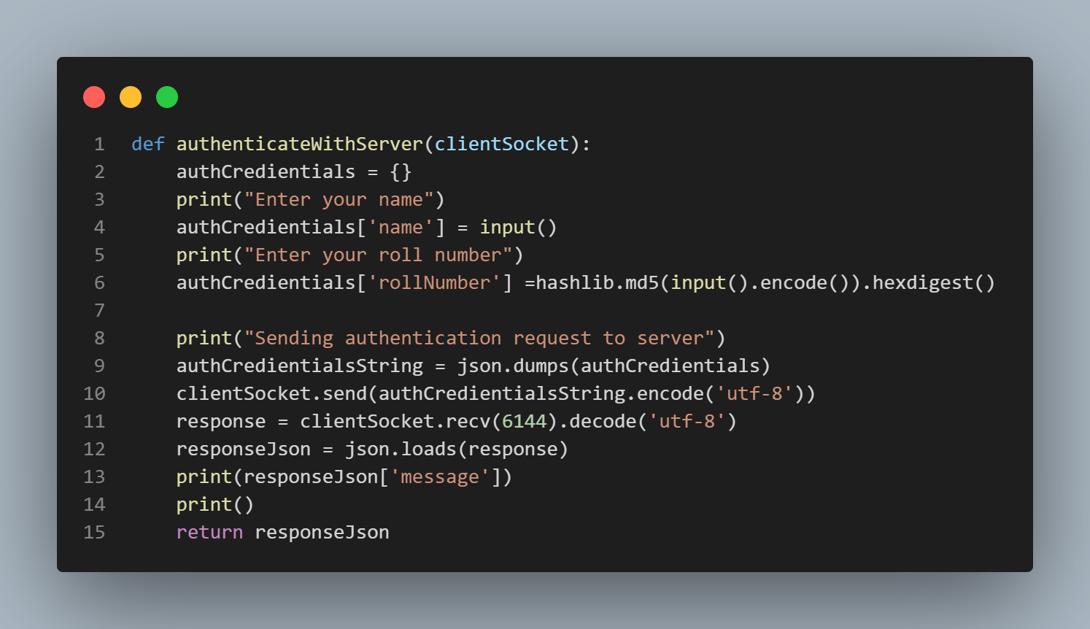

Slide 5
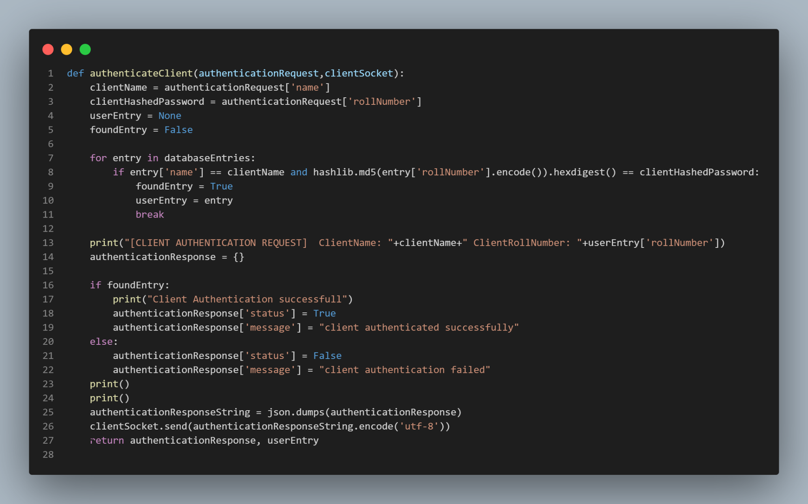

Slide 6
Encrypting Data
The received data is encrypted with a password which is currently the DOB of the user
This password can be replaced by the public key of the user and hence can only be decrypted by the user’s private key
Design similar to Aadhar card

Slide 7
Message Integrity
Message Integrity is check using the signed HMAC of Director and Registrar.
If both of them are valid then only message is considered valid
Design choice is similar to certificate chaining where root certificate is trusted by everyone and then chaining is supported

Slide 8
Securing Timestamps
Secure timestamps is obtained using NTP server and system time is not uses
Advantages:
Avoid tampering with the system time

Slide 9
Sharing with other Clients
Again message integrity is checked similar to certificate chaining.

